Slide 1
Research Seminar Group Project
Seif Yacoub Daria Sadykova Julia Sitdikova Sofia Tarasova
Vladimir Dashevkiy

Slide 2
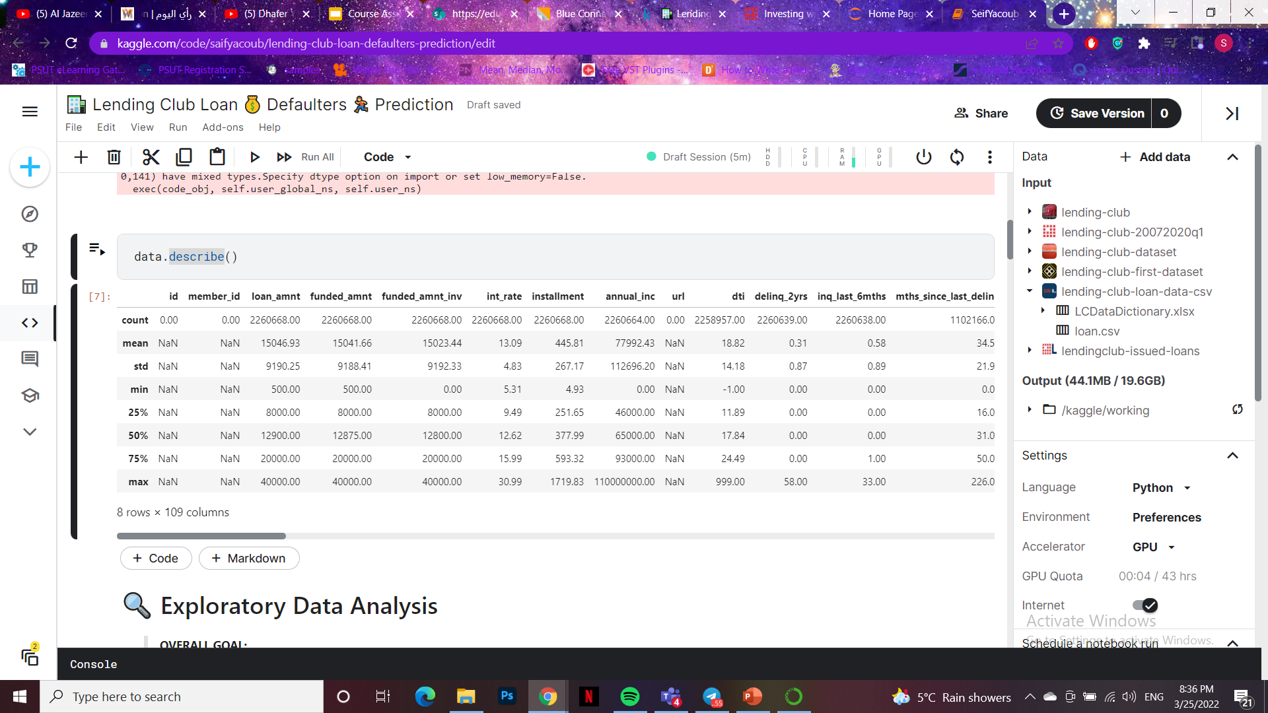
The Used Data:
Overview:
The dataset is called (Lending Club Loan Data). Leadingclub is basically a loaning company.
This dataset includes all the data from LendingClub's website. Accepted and denied loans each have their own file. FICO scores are included in the accepted loans as well. After examining the dataset, we found out that it satisfies our project goals.
Data Size & Shape:
The dataset we used has a size of: (1.19 GB).
And a shape of: (2260668, 145).
Data Source:
https://www.kaggle.com/code/faressayah/lending-club-loan-defaulters-prediction/data?select=loan.csv

Slide 3
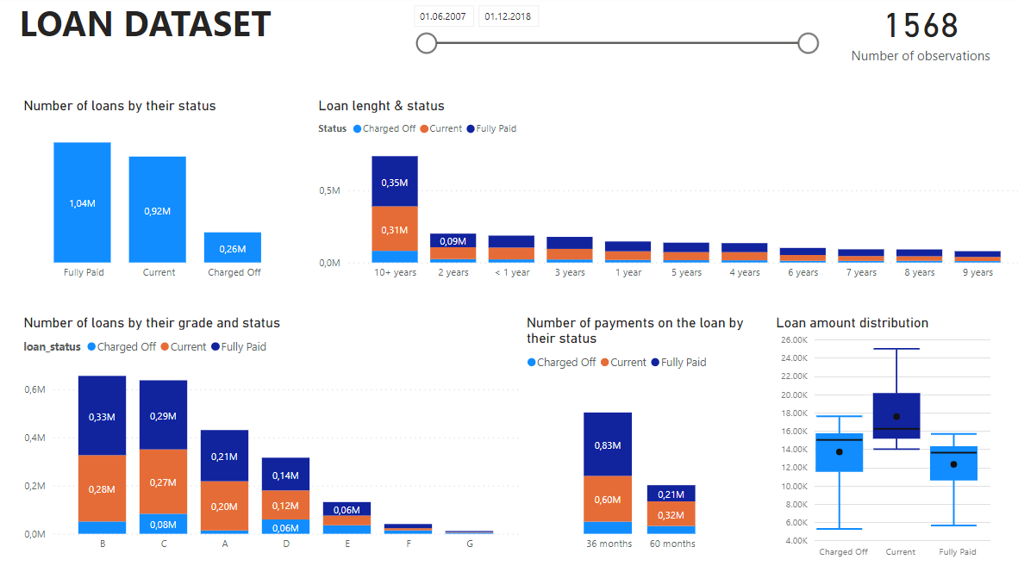
Dataset Visualisation in Power Bi

Slide 4
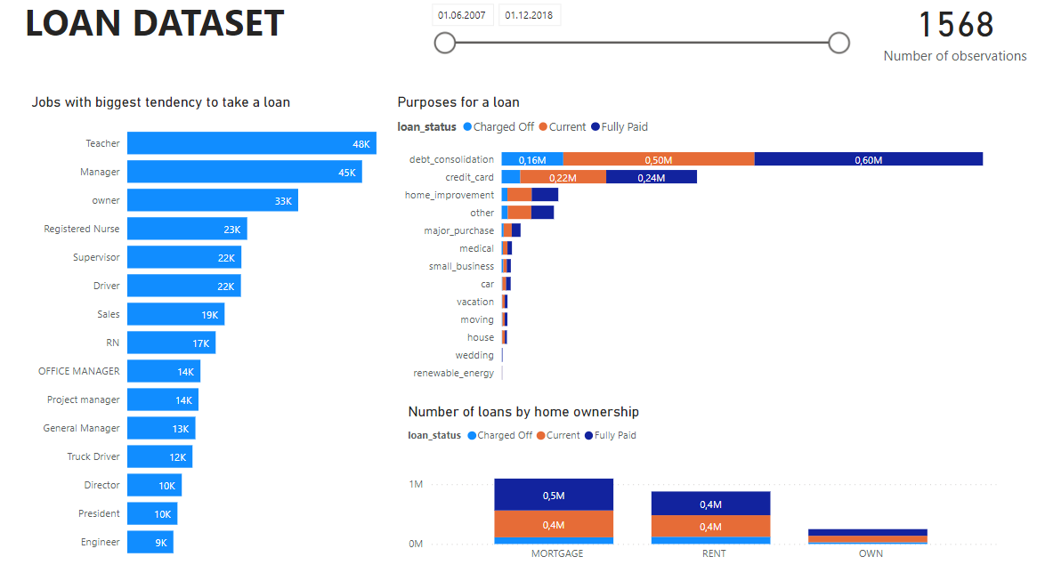
Dataset Visualisation in Power Bi

Slide 5

Data Mining
We used python for Data Mining process
After loading and importing the needed libraries for our data, we used a theory to reach out final goal.
The theory as the following:
Expected Loss (EL) on a given is calculated using the loan amount multiplied by a loan's probability of default (PD) multiplied by the loan's loss given default (LGD). Loss Given Default is the amount of the loan that is deemed unrecoverable and is represented as a number between 0 (no loss) and 1 (100% of the loan is a loss)
The equation for EL is given as:
* EL = PD x LGD x Loan Amount
After selected features using the 5 C's of Credit Framework and adjusting for the skewedness in the data (there is a greater proportion of loans in the portfolio that have NOT defaulted versus loans that HAVE defaulted) we will model probabilities of default using classification models.

Slide 6
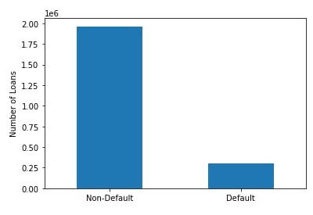
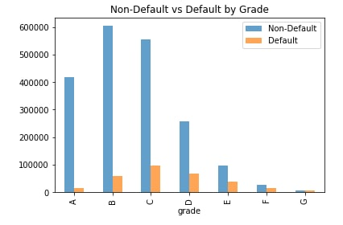
Data Visualisation:

Slide 7
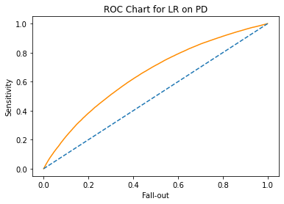
For the Final Result
AUC-ROC Curve
We can see that our logistic regression model is better than random classifier, with accuracy about 0.61
NOTE:AUC - ROC curve is a performance measurement for the classification problems at various threshold settings. ROC is a probability curve and AUC represents the degree or measure of separability. It tells how much the model is capable of distinguishing between classes.

Slide 8
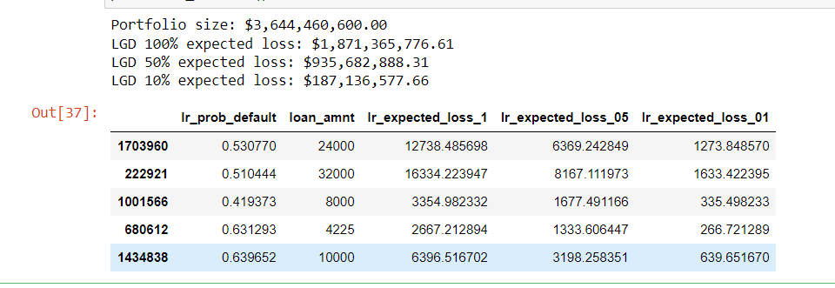
The Final Results of Our Model
After Creating an expected loss columns for each model using the formula mentioned in the theory (* EL = PD x LGD x Loan Amount). We got the following results for our module:

Slide 9
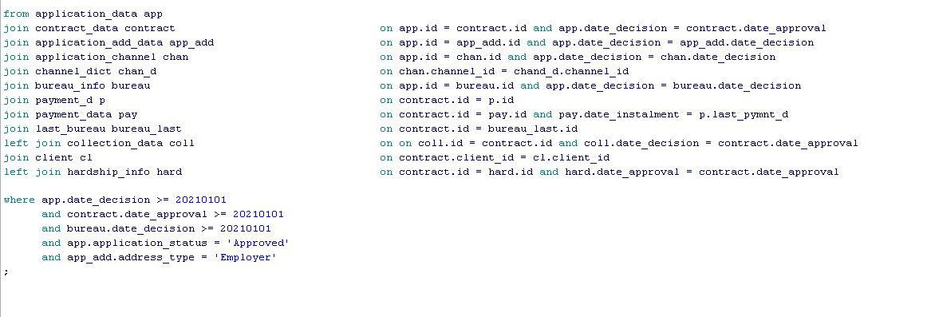
Data Processing
We wrote our script on SQL
We have created several tables with facts and dictionaries, such as application_data and application_channels. We also separated application and contract into different entities. Full tables can be seen here, in join:

Slide 10
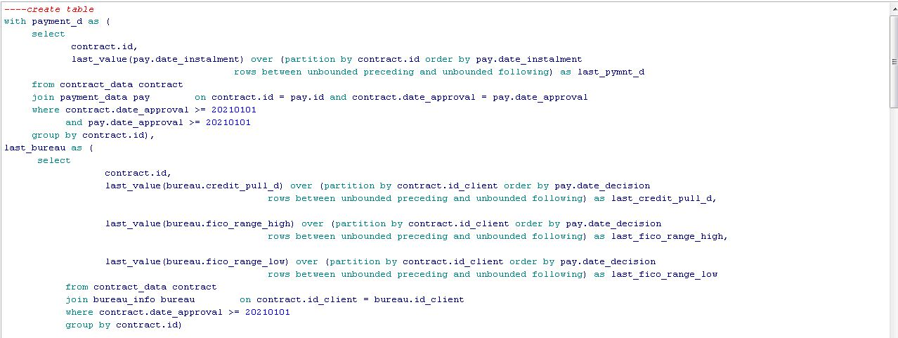
Data Processing
We wrote our script on SQL
We also had to aggregate some tables like payment_data to get one row for one application_id:

Slide 11
Thanks!
Any questions?

Slide 12
Team Presentation
Seif Yacoub
Daria
Sadykova
Julia
Sitdikova
Sofia
Tarasova
Vladimir
Dashevskiy

